Slide 1
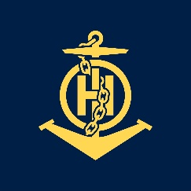
IHO-Nippon Foundation Alumni Seminar Singapore 2019
IHO – NIPPON FOUNDATION
ALUMNI SEMINAR
Mr. MAHI Abderrahim
Algerian Naval Forces Hydrographic Office

Slide 2
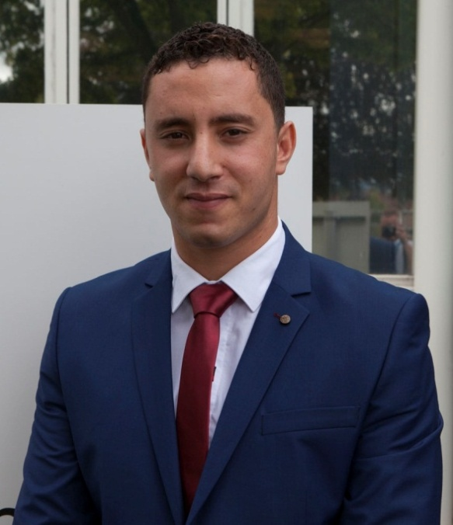
Self introduction
IHO – NIPPON FOUNDATION
ALUMNI SEMINAR
Name | MAHI Abderrahim
Alumni year | 2017
Country | ALGERIA
Organization | NAVAL FORCES HYDROGRAPHIC OFFICE
Position/Job title | NAUTICAL CARTOGRAPHER
Current job description | PAPER CHART PRODUCTION

Slide 3
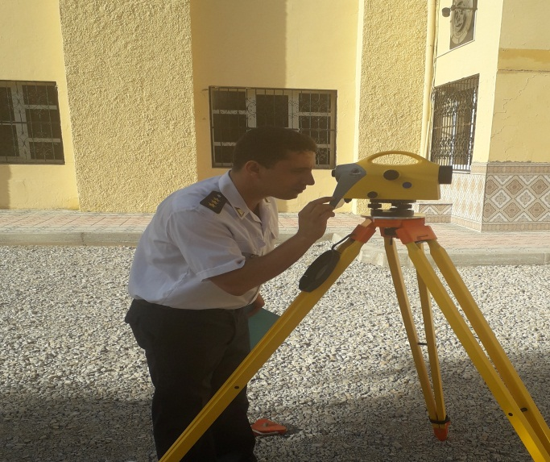
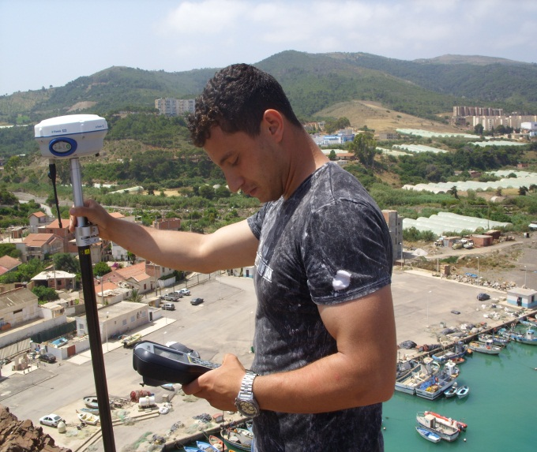
My career path and projects / Before the course
IHO – NIPPON FOUNDATION
ALUMNI SEMINAR
As a geodesy engineer, my role in the hydrographic office, before the course, was to ensure some initial phases of the chart production, including preparation and carrying out topographic surveys, and to deal with all aspects that have a relationship with geodesy as geodetic systems and projections…ext,

Slide 4
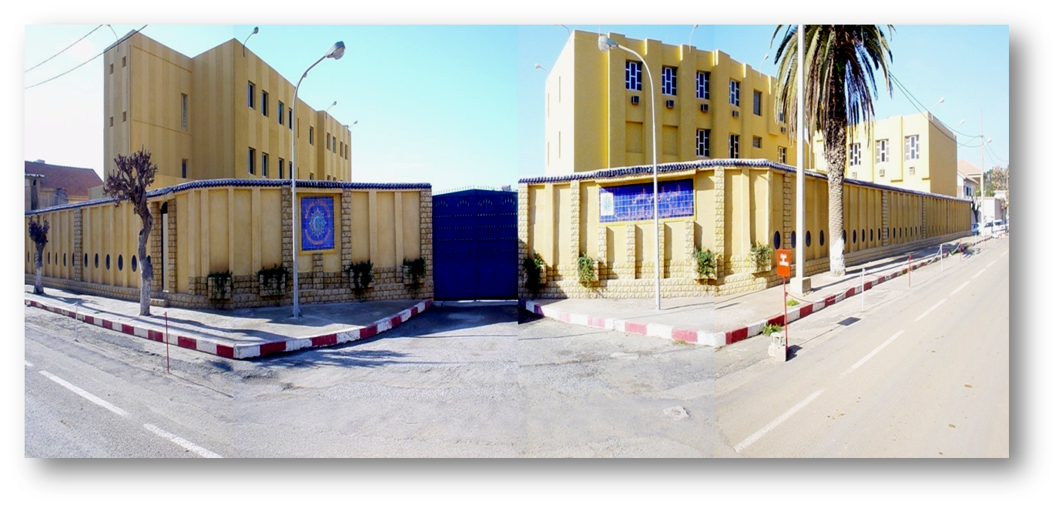
My career path and projects / Before the course
IHO – NIPPON FOUNDATION
ALUMNI SEMINAR
However the fact of working in an office dedicated to nautical cartography with cartographers allowed me to gain a basic knowledge on both ENCs and paper charts.
Honestly the lack of qualified staff in marine cartography in general and precisely in ENCs was always an obstacle against the development of the production especially with a coast of more than 1400 km.
NAVAL FORCES HYDROGRAPHIC OFFICE

Slide 5
My career path and projects / Before the course
IHO – NIPPON FOUNDATION
ALUMNI SEMINAR
That's why this course was for me a golden opportunity to, first, help my office to produce more and with a better quality, and secondly the beautiful stories that my friend never stopped telling gave me a lot of enthusiasm to be able to live the same experience
My selection for the course changed my professional life not only because I started to be involved in the last stages of nautical chart production but also because it gave me a general idea about this field on an international level.

Slide 6
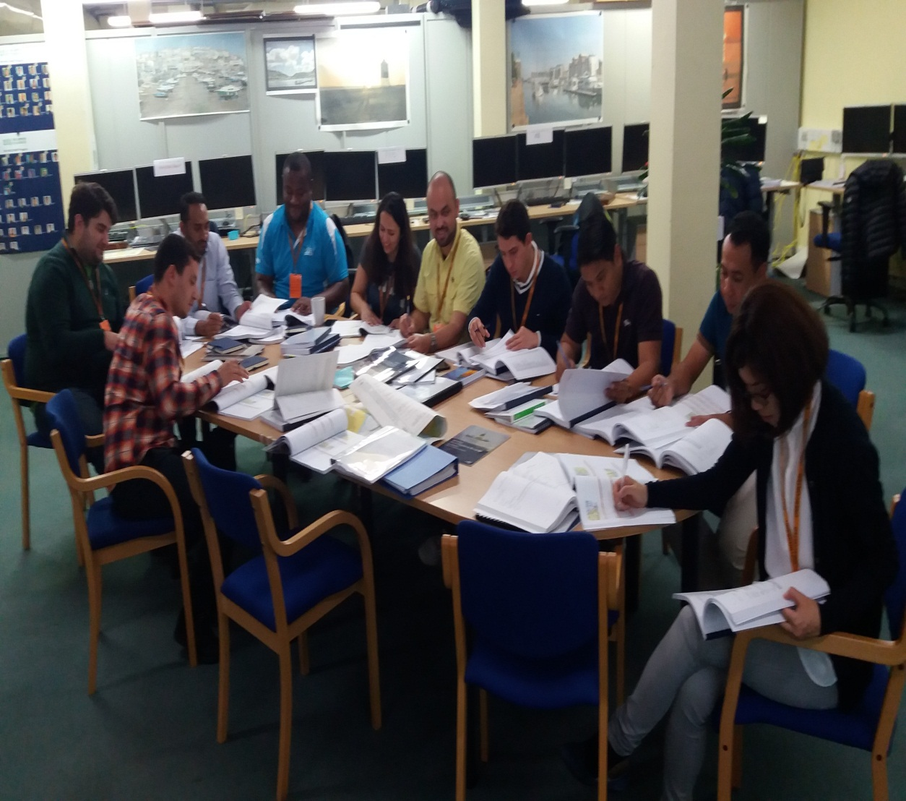
Lessons learned from CHART Course
IHO – NIPPON FOUNDATION
ALUMNI SEMINAR
I'm not going to spend a lot of time talking about the course program because you already know it, but I'm going to talk briefly about its influence on me.
In the pre-learning and foundation modules we started with basics that the majority of students had in common

Slide 7
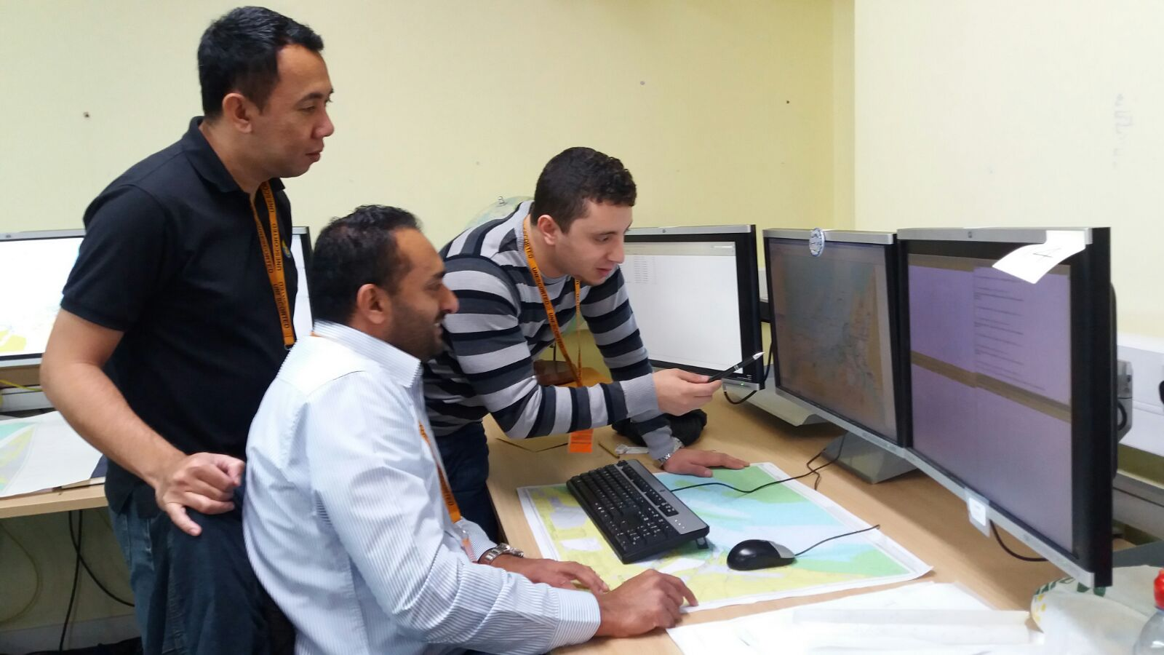
Lessons learned from CHART Course
IHO – NIPPON FOUNDATION
ALUMNI SEMINAR
Then we passed to the compilation module when we learned how to compile all the relevant nautical chart content in compliance with iho-s57 standard,
After that we started to build our ENC’s from the previous compiled data in the production module.
Notes:
for me the difficult part was to determine in which object class this object should be encoded but with the help of training staff I ended up mastering it.

Slide 8
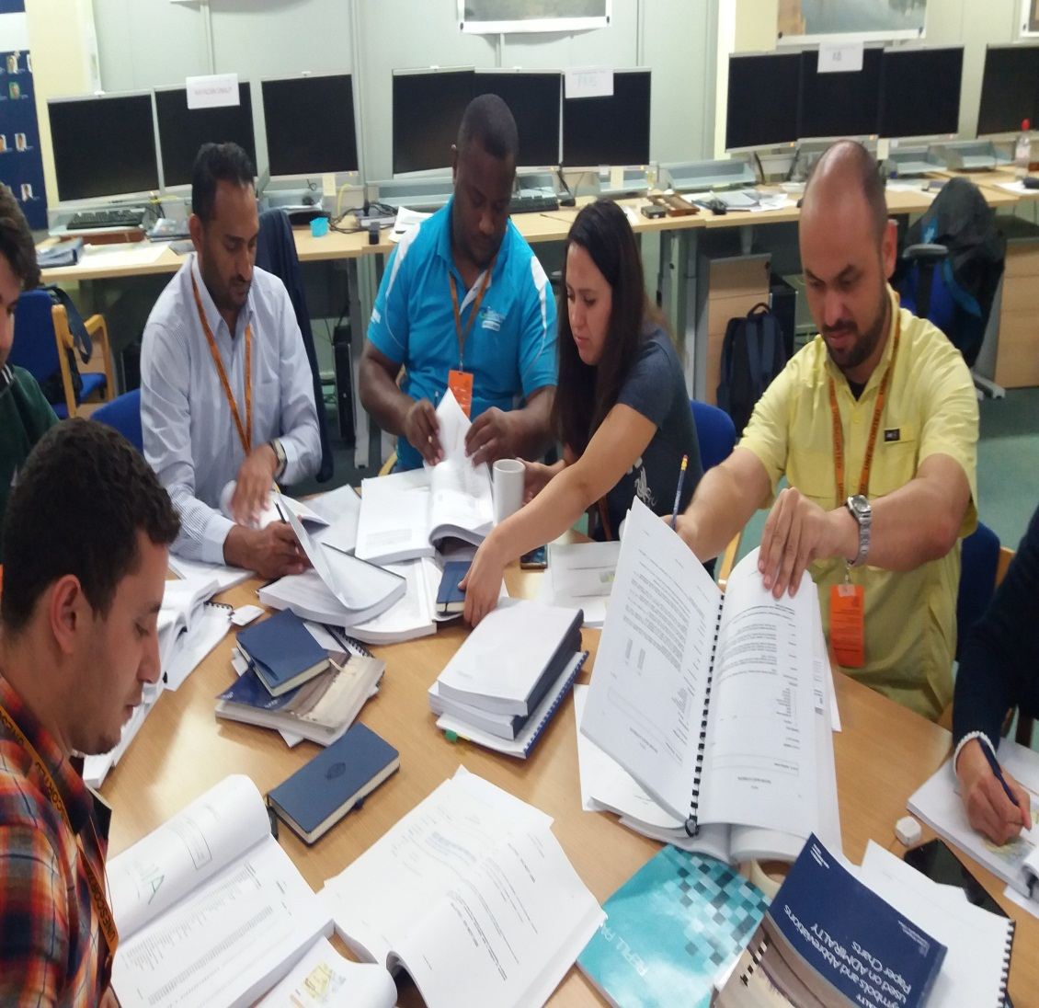
Lessons learned from CHART Course
IHO – NIPPON FOUNDATION
ALUMNI SEMINAR
For data assessment module, in the beginning the decision making about new information was not quite easy for me because it depended much more on UKHO policy which is a little bit different from ours.
We saw later how to establish, if it is decided, a notice to mariners or a new edition in the maintenance module.
Notes:
and that is due in my opinion to the huge amount of information received by the UKHO unlike my office but thanks to the training staff again I adapted to their method.

Slide 9
Lessons learned from CHART Course
IHO – NIPPON FOUNDATION
ALUMNI SEMINAR
The final project was a kind of recap to most of the lessons learned in the preceding modules, while we were asked to compile a chart using all the knowledge and skills gained, so it was the best thing to finish the course and an opportunity for the trainers to go back and explain some ambiguities and at the same time to assess the level reached by each student.
I think I was satisfied about the quality of my final project I even have it now hanging on the wall of my office.

Slide 10
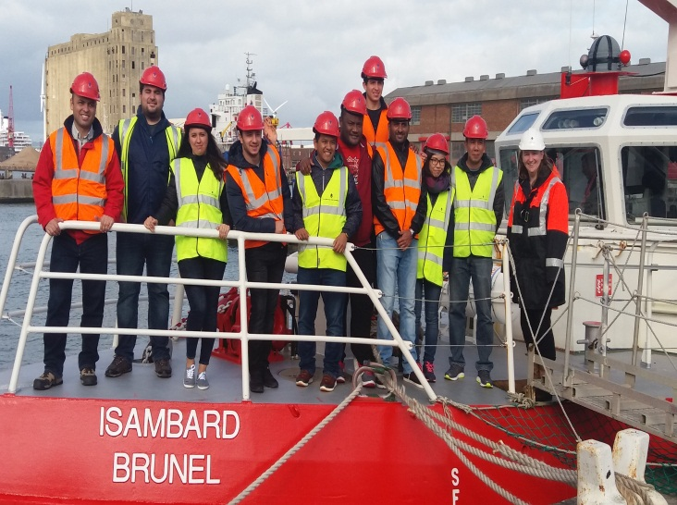
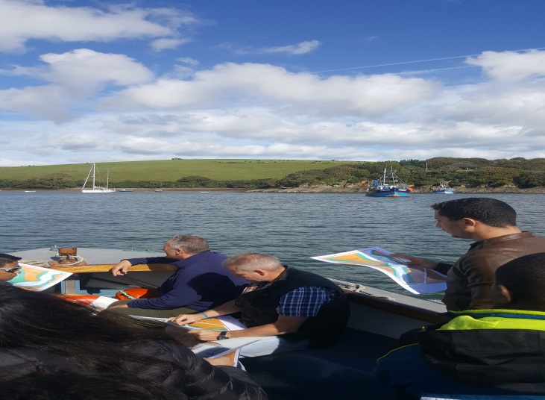
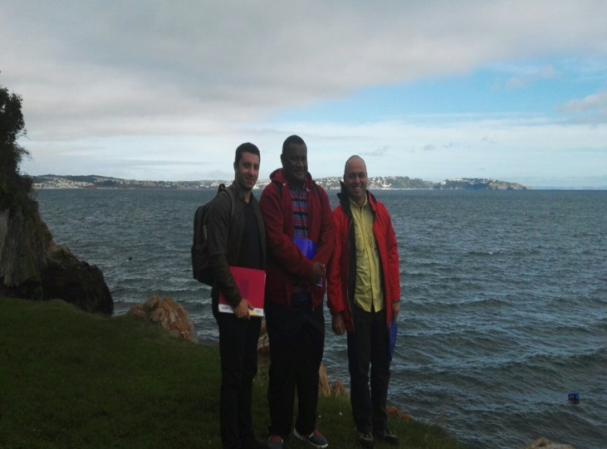
Lessons learned from CHART Course
IHO – NIPPON FOUNDATION
ALUMNI SEMINAR
Among the most exciting moments of the training were the field trips they were very beneficial in the way we could analyze the actual situation on ground before making changes to the chart.

Slide 11
My career path and projects / After the course
IHO – NIPPON FOUNDATION
ALUMNI SEMINAR
After completing the course and returning to work I can honestly say that I have improved several things on our charting process.
Although I work more on paper charts but I don’t miss the opportunity to help and assist in the realization of the electronic charts to improve the production process on one hand, and to regularly manipulate ENC’s to keep the knowledge acquired on the other hand.

Slide 12
My career path and projects / After the course
IHO – NIPPON FOUNDATION
ALUMNI SEMINAR
This year i will occupy the position of head of ENC 'section, the big challenge for me will be to review the scheming, make some changes. The good thing is that this year hopefully we will sign an agreement with an ENC Coordinating Center (RENC) which will take our electronic cartography to the next level.

Slide 13
Suggestion for the future
IHO – NIPPON FOUNDATION
ALUMNI SEMINAR
The things about this training are so perfect that I couldn’t find any suggestions except the planning of more seminars like this because it’s a wonderful opportunity to periodically strengthen the IHO-NF alumni network.

Slide 14
IHO – NIPPON FOUNDATION
ALUMNI SEMINAR
Last but not least, I would like to thank everyone who was involved in the preparation and execution of the project, particularly the Nippon foundation , the IHO , the UKHO especially our trainers you have all done a wonderful job , i hope that this project will be continued for many years and will meet your expectations.

Slide 15
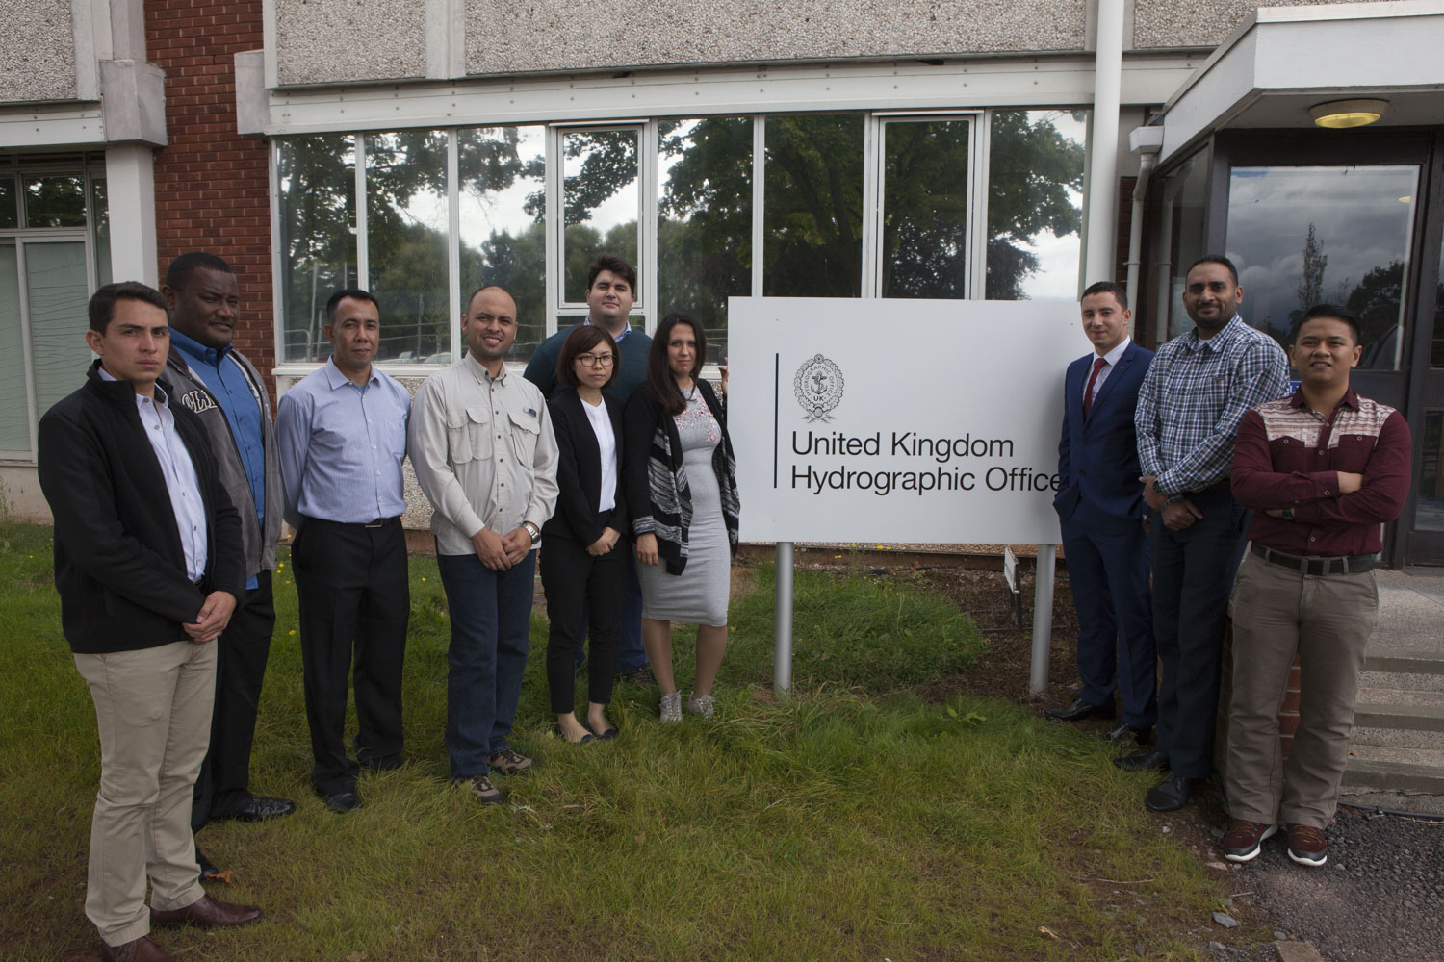
IHO – NIPPON FOUNDATION
ALUMNI SEMINAR
THANK YOU FOR YOUR ATTENTION

